Slide 1


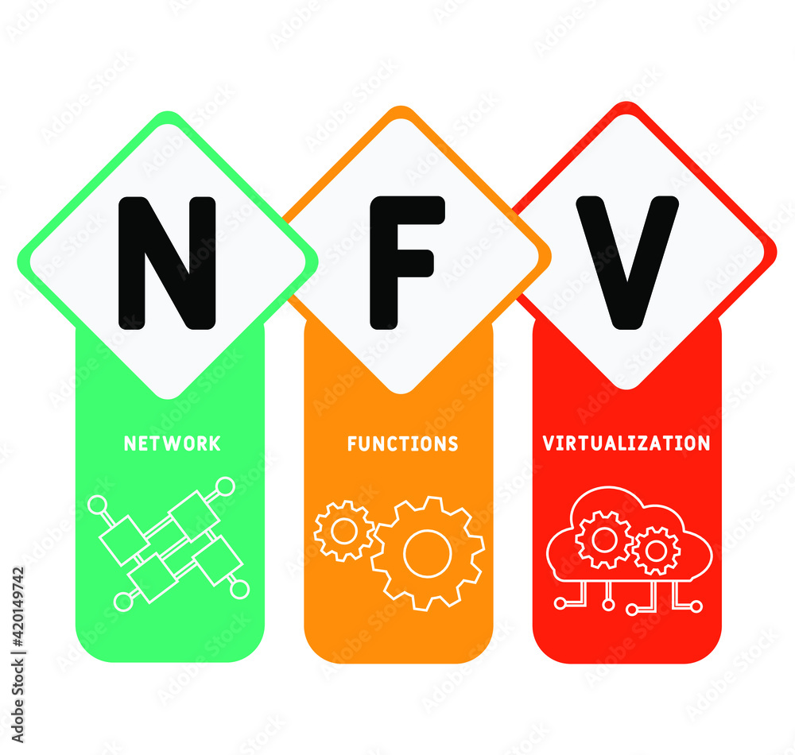
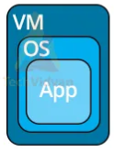
PDS
Computer Vision
Apps
IoT Flutter Android_Part 2
.
https://github.com/siagianp
https://www.youtube.com/@AmelOline/videos
https://github.com/amelcharolinesgn2/IoT_simulator-mqtt-NodeRed
https://github.com/amelcharolinesgn2/Cloud-Infrastructures
https://github.com/amelcharolinesgn2/ClouD-Infrastructure-SISKA-2025
Notes:
https://www.itwonderlab.com/kubernetes-with-terraform/

Slide 2
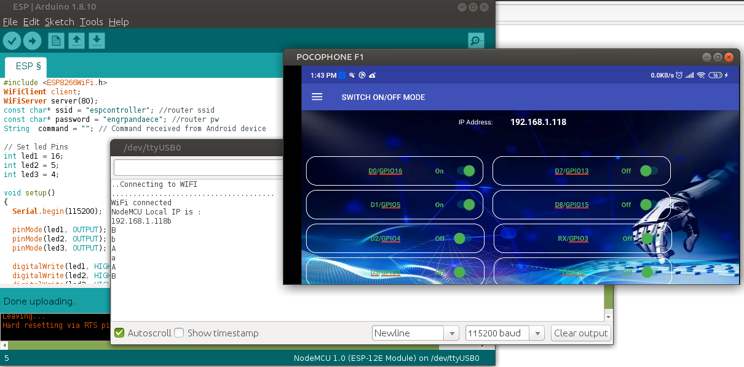
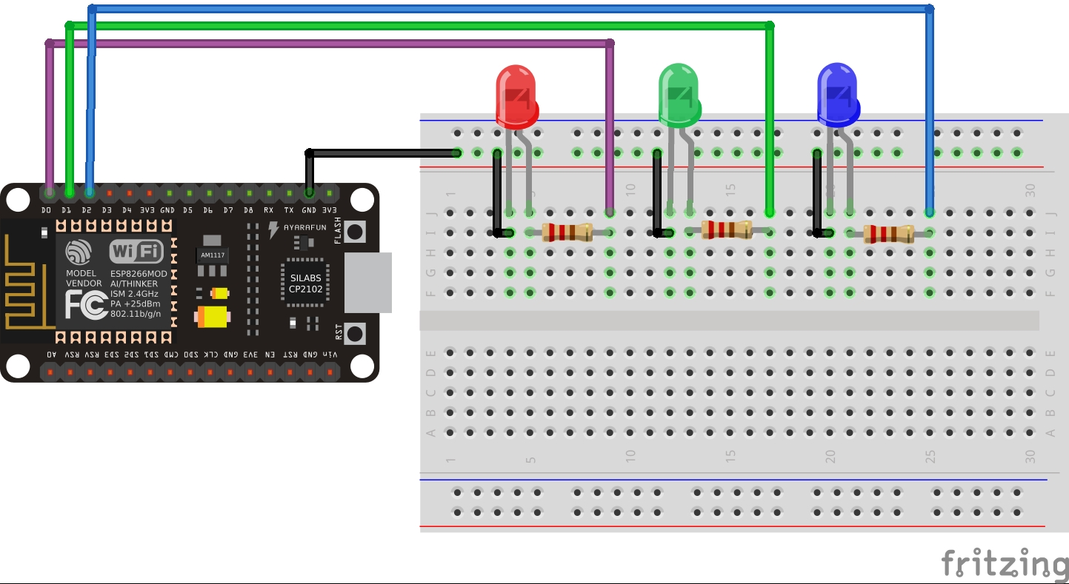
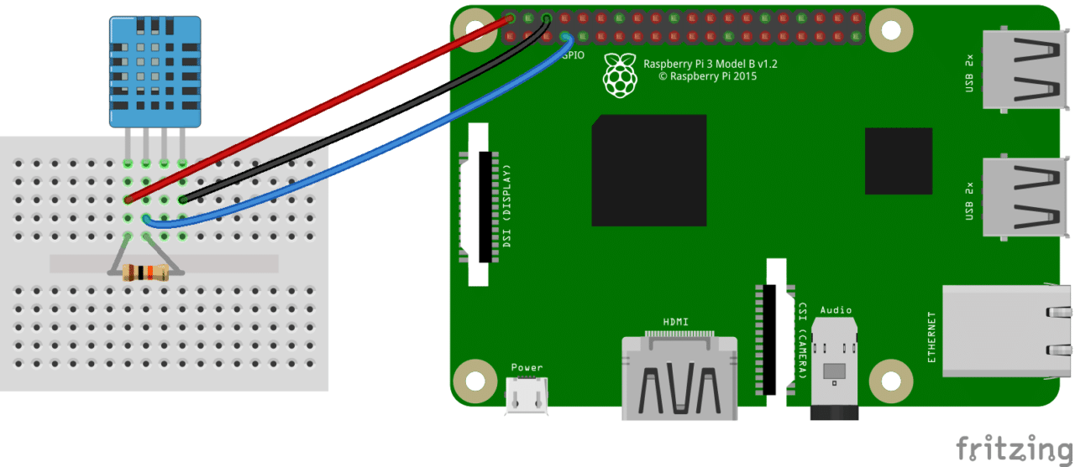
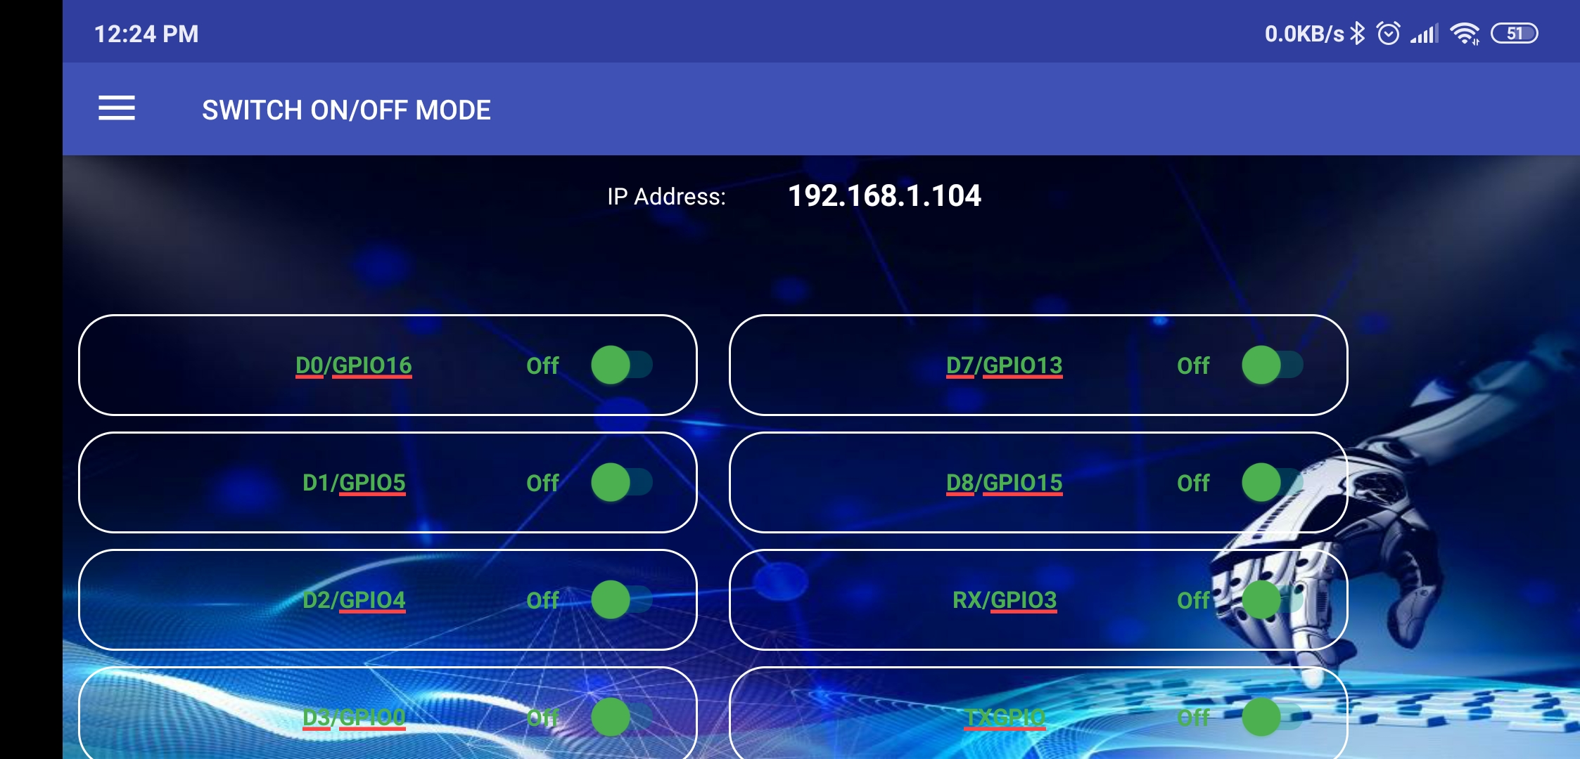
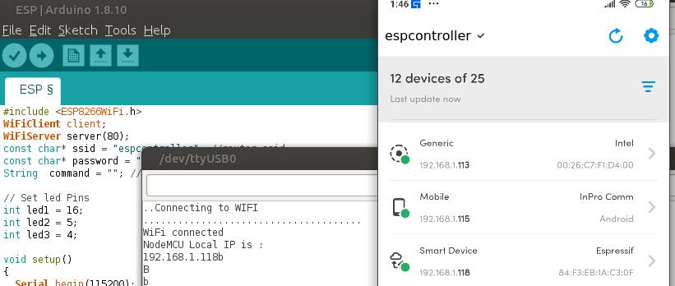
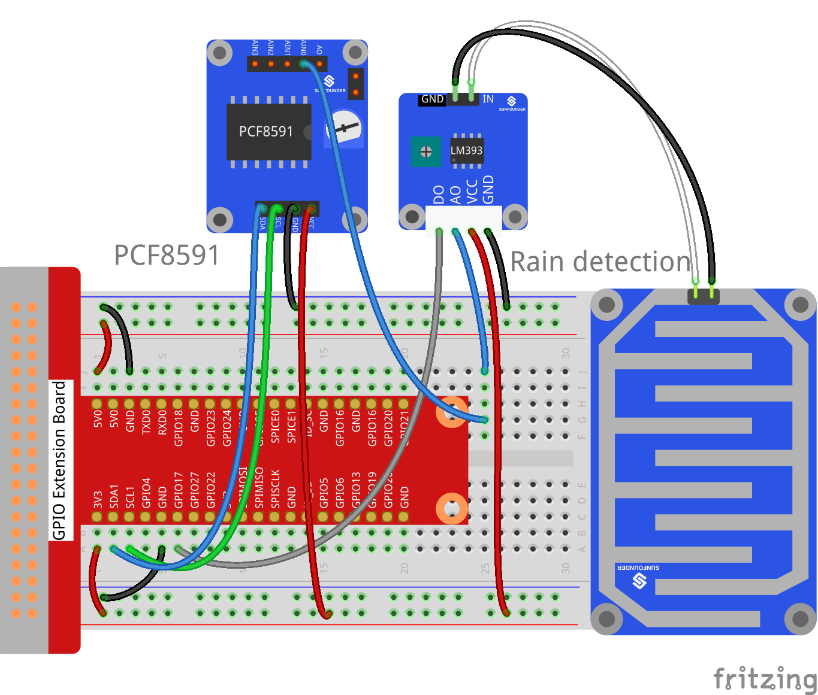
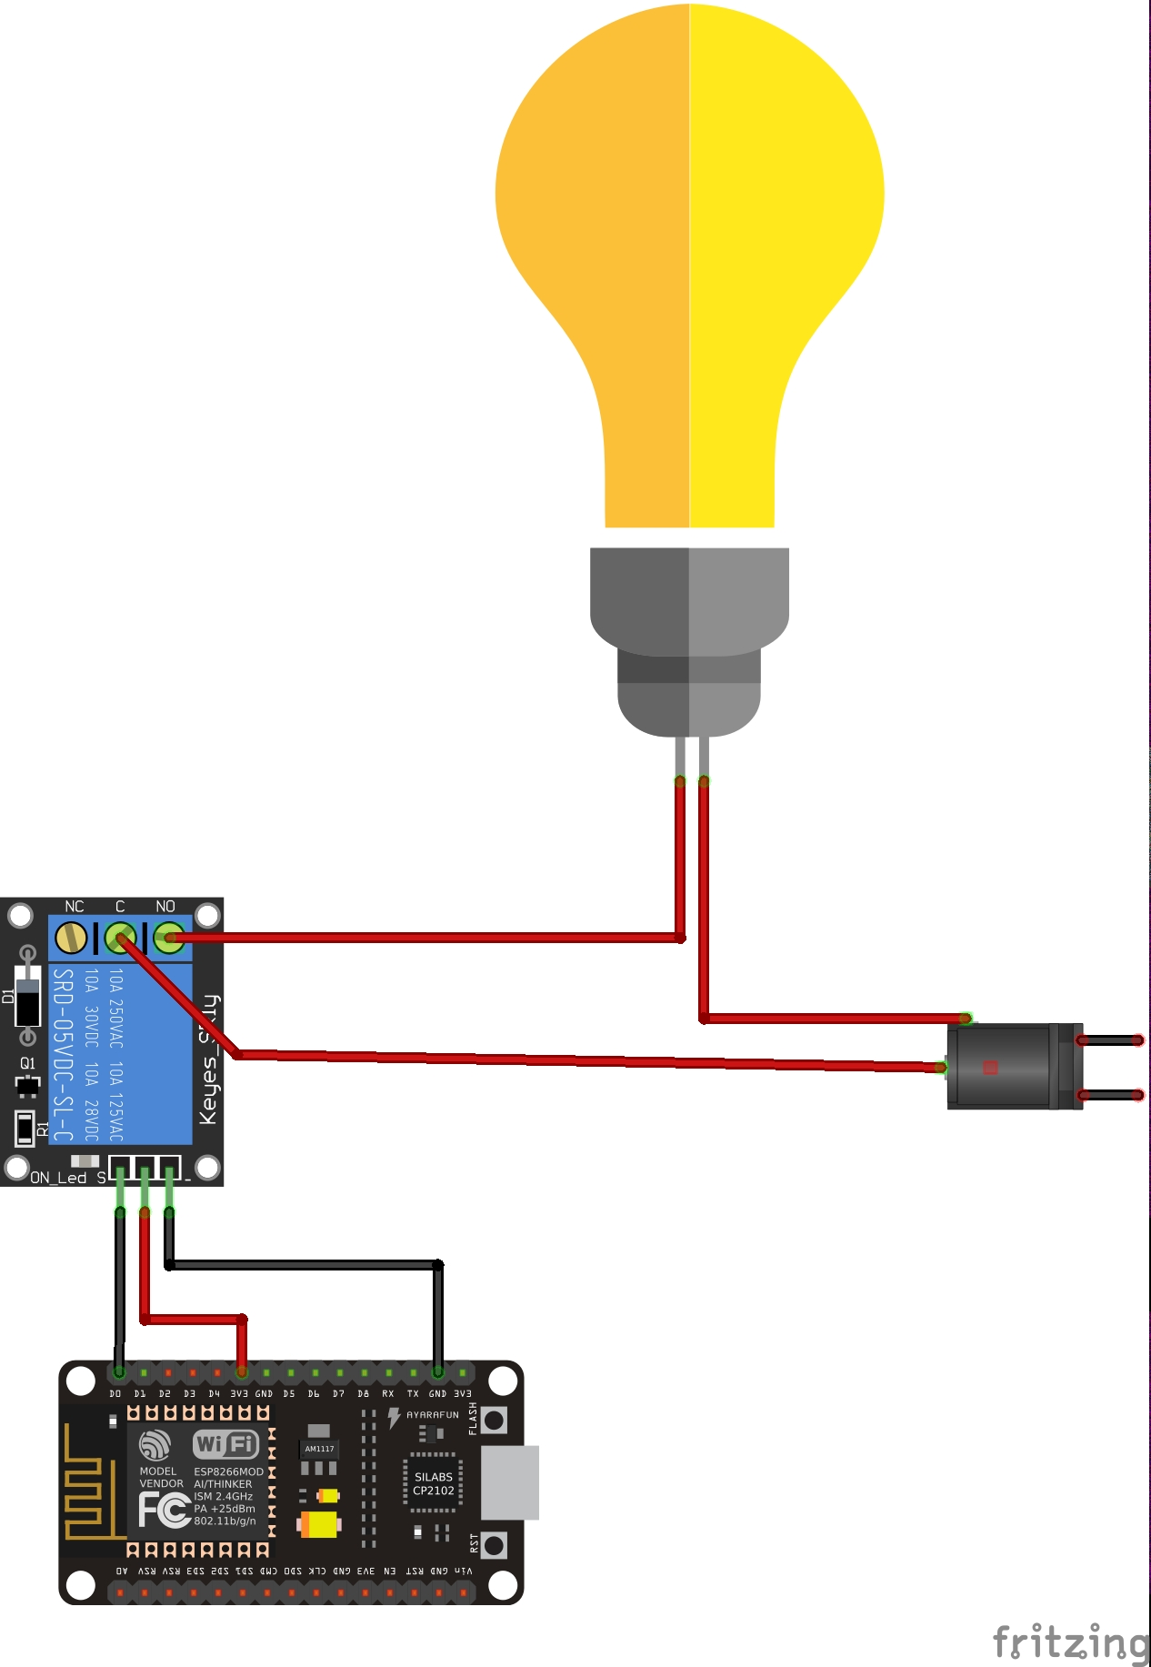
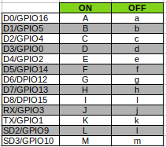
Smart Garden
Ultra
ESP8266-Controller-plus-ULTRA
IoT Smart Gardening App
Telegram bot
thingspeak
Notes:
https://github.com/iotprojectMPEG/smartgarden https://github.com/engrpanda/ESP8266-Controller-plus-ULTRA
Tools
Python 3.6 or higher
MQTT message broker
https://github.com/engrpanda/ESP8266-Controller-plus-ULTRA

Slide 3
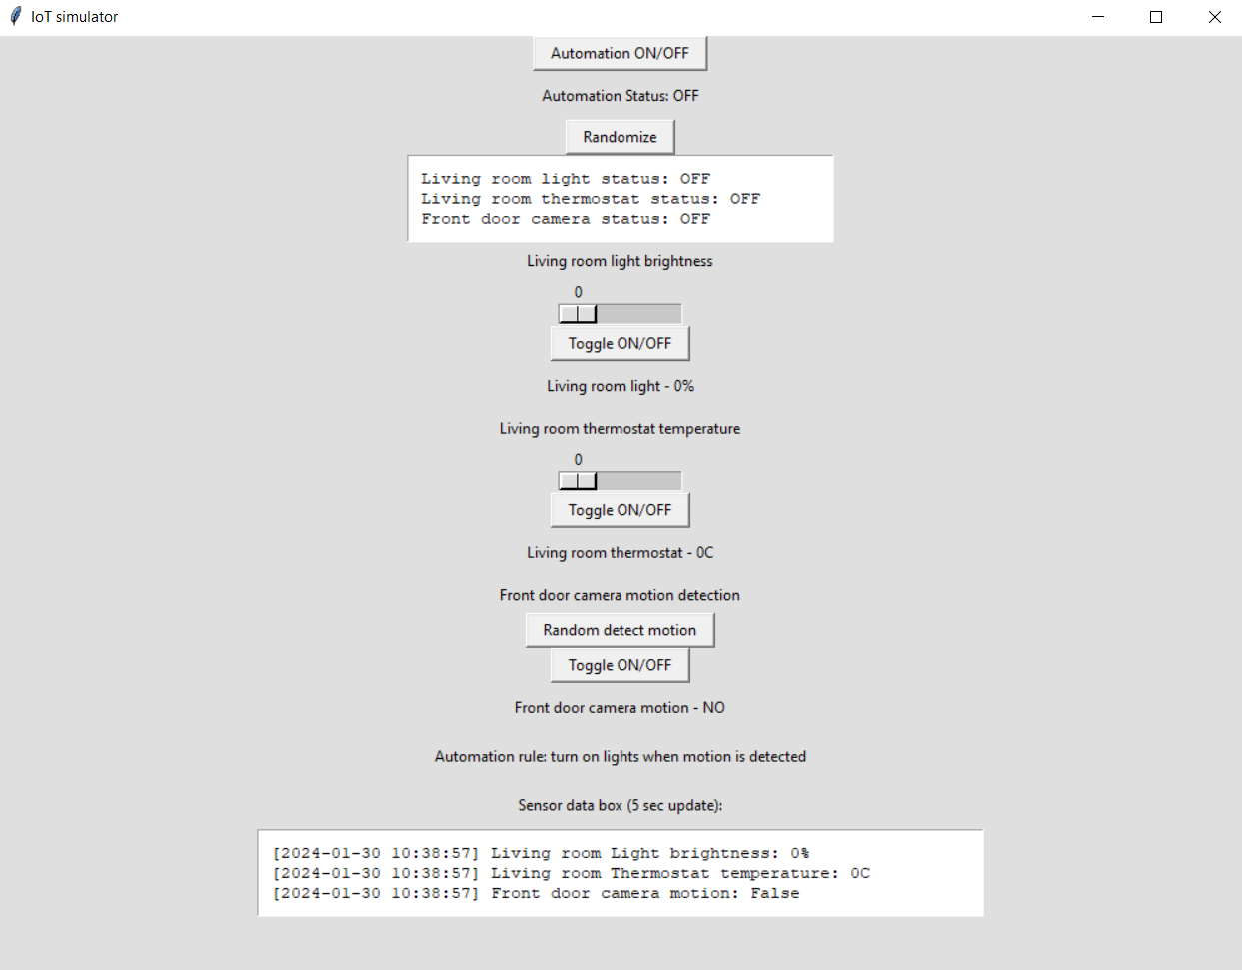
IoT simulator
GUI allows monitoring of the smart home system through several text fields which are implemented on the dashboard. For example, to see the current status (“ON” or “OFF”) of all the devices it is enough to check the text box which goes right after the “randomize” button on the top. To check the current state of core feature of each device, for instance brightness of the light, it is enough to look at the text right after the button “Toggle ON/OFF”. For controlling the smart home system there are located different buttons and scales. For example, to turn on the automation you can tap on the first button on the top of the page called “Automation ON/OFF”. To adjust different things to devices and change their statuses you can interact with buttons and scales which were created for each device. Hence, to change the brightness of the light you can pull the scale which is under the text “Living room light brightness”.
Python-based IoT simulator for a smart home automation system. The simulator emulates the behavior of various IoT devices commonly found in a smart home. Some of these devices are smart lights, thermostats, and security cameras. There is also a central automation system that manages these devices. The monitoring dashboard GUI will help to visualize and control the smart home.
Notes:
https://github.com/leedskiy/IoT-simulator

Slide 4
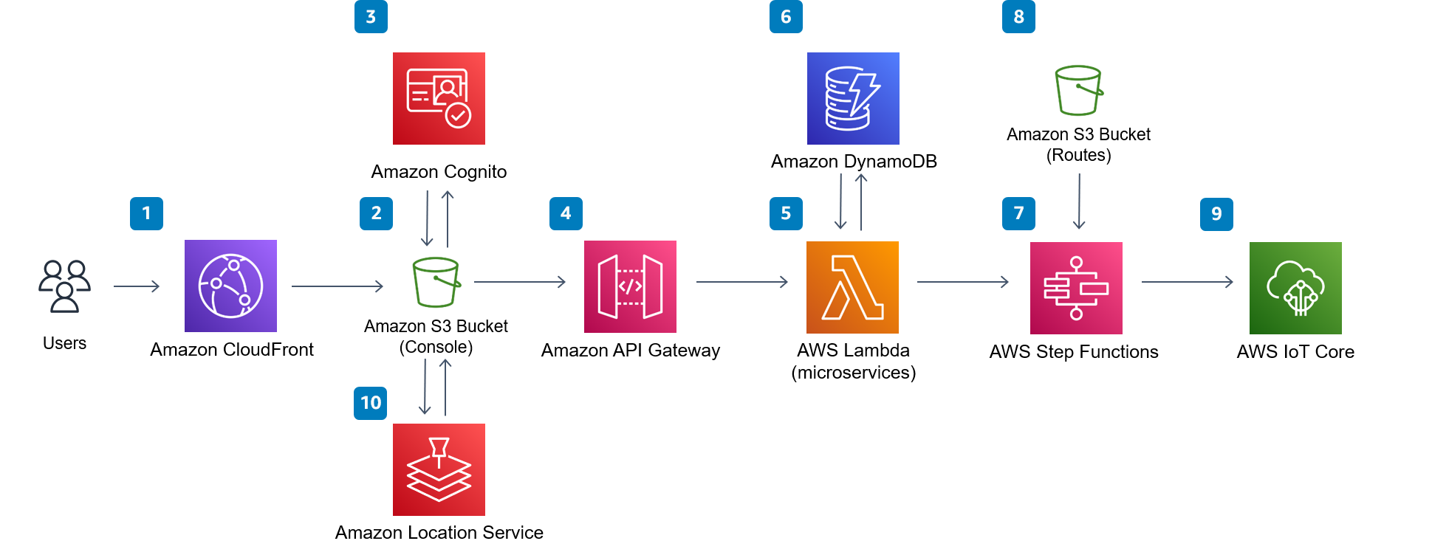
AWS
Ajure
Azure
IoT Sensor Data Simulator
AWS
The IoT Device Simulator solution has been deprecated and will not be receiving any additional features or updates. You can explore other Solutions in the AWS Solutions Library..
Notes:
https://github.com/aws-solutions/iot-device-simulator
https://github.com/antonsarg/iot-sensor-data-simulator

